Slide 1

Lecture 4
PostgreSQL & Knex

Slide 2

A G E N D A
What is PostgreSQL?
What is Knex?
Crafting Database with PostgreSQl & Knex
Migrations
Seeds
Notes:
In this chapter, we will talk about the concept of keys, and the two types of keys in SQL databases, namely Primary keys and foreign keys. Then we will deep dive into the 3 types of table relationships in SQL databases.

Slide 3

What is PostgreSQL?
PostgreSQL, commonly referred to as Postgres, is a free and open source relational database management system. You might be familiar with a few other similar database systems, like MySQL, Microsoft SQL Server, or MariaDB, which compete with PostgreSQL.
PostgreSQL is a robust relational database that has been around since 1997. It’s available on all major operating systems — Linux, Windows, and macOS. Since PostgreSQL is known for stability, extensibility, and standards compliance, it’s a popular choice for developers and companies.

Slide 4
Installation
Creating a PostgreSQL database
Before you can use PostgreSQL, you have to create a PostgreSQL database. You can create the database locally by installing PostgreSQL on your system.
Installation：Download a Windows installer of PostgreSQL. If you are windows user, you could refer to this tutorial video or this tutorial article on installing PostgreSQL. If you are a Mac user instead, you refer to this tutorial video on installing PostgreSQL.
The primary target environment for Knex is Node.js, you will need to install the knex library, and then install the appropriate database library.
npm install knex pg --save

Slide 5
What is Knex?
Knex.js is a JavaScript query builder for relational databases that can be used with Node.js. It provides a straightforward interface for building and executing SQL queries in JavaScript, supporting multiple database systems, such as PostgreSQL. PostgreSQL is a popular relational database system widely used in modern web applications and other software systems.
In this article, we’ll look into crafting Database Models With Knex.js and PostgreSQL.

Slide 6
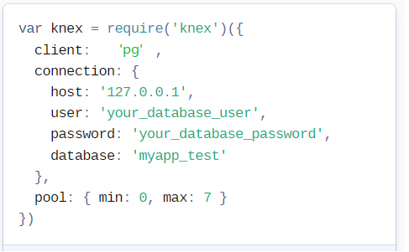
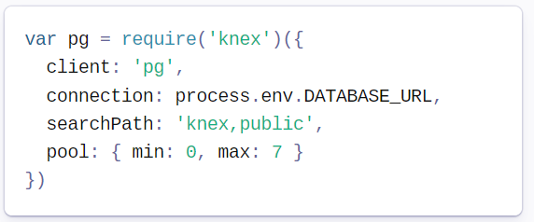
Connect database
Connect via host
Connect via URL

Slide 7
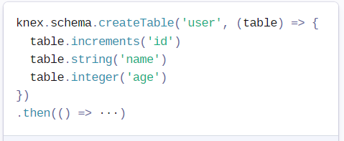
Create table with Knex
knex.schema.createTable(tableName, callback)
Creates a new table on the database, with a callback function to modify the table's structure, using the schema-building commands.

Slide 8
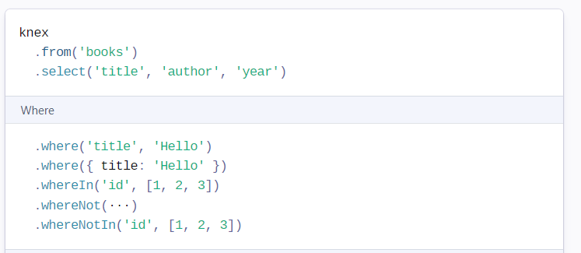
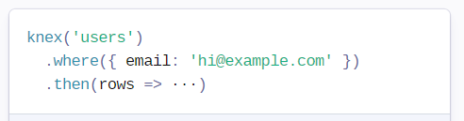
Select query
.select([*columns])
Creates a select query, taking an optional array of columns for the query, eventually defaulting to * if none are specified when the query is built. The response of a select call will resolve with an array of objects selected from the database.

Slide 9
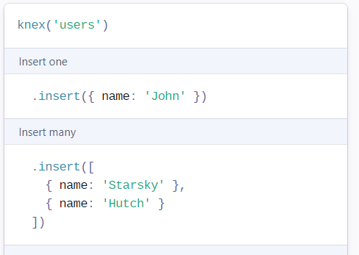
Insert new data
.insert(data, [returning], [options])
Creates an insert query, taking either a hash of properties to be inserted into the row, or an array of inserts, to be executed as a single insert command.

Slide 10
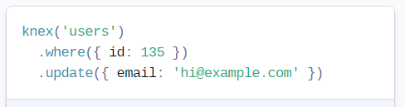
Update data
.update(data, [returning], [options]).update(key, value, [returning], [options])
Creates an update query, taking a hash of properties or a key/value pair to be updated based on the other query constraints.

Slide 11
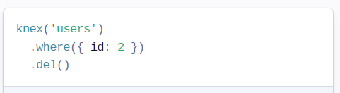
Delete data
.del([returning], [options])
Aliased to del as delete is a reserved word in JavaScript, this method deletes one or more rows, based on other conditions specified in the query.

Slide 12
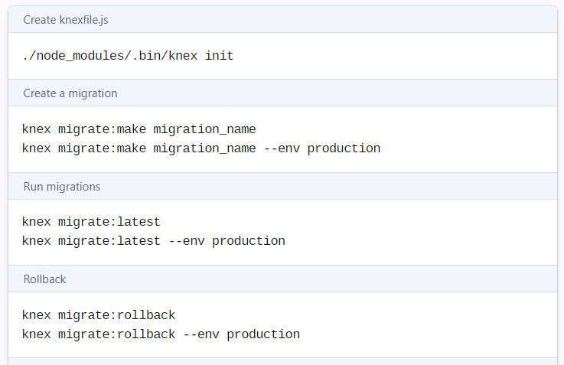
Migrations
Migrations allow for you to define sets of schema changes so upgrading a database is a breeze.

Slide 13
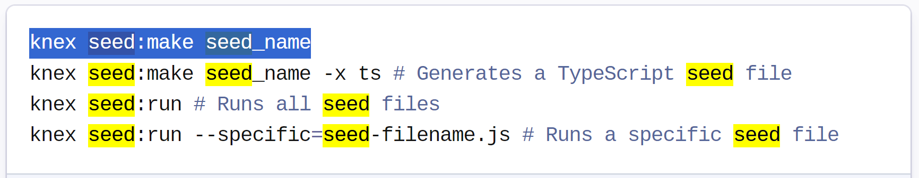
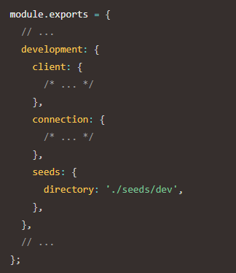
Seed
Seed files allow you to populate your database with test or seed data independent of your migration files.
Seed files are created in the directory specified in your knexfile.js for the current environment. A sample seed configuration looks like:

